Slide 1


RI THEME & GOALS
Dave Osei Amankwah
District Governor RI D9104
2023-2024

Slide 2
ROTARY INTERNATIONAL
PRESIDENT-ELECT

Slide 3

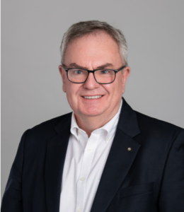

Gordon McInally
Rotary International
President
2022-2023
Rotary Club at South Queensferry,
West Lothian, Scotland

Slide 5

Bio and RI President’s Message

Slide 6
RI President’s Message
CONTINUITY
EMPOWERING GIRLS
DEI
POLIO
VISION STATEMENT
MENTAL HEALTH
IMPACT
REACH
ENGAGEMENT
ADAPT

Slide 7


Slide 8
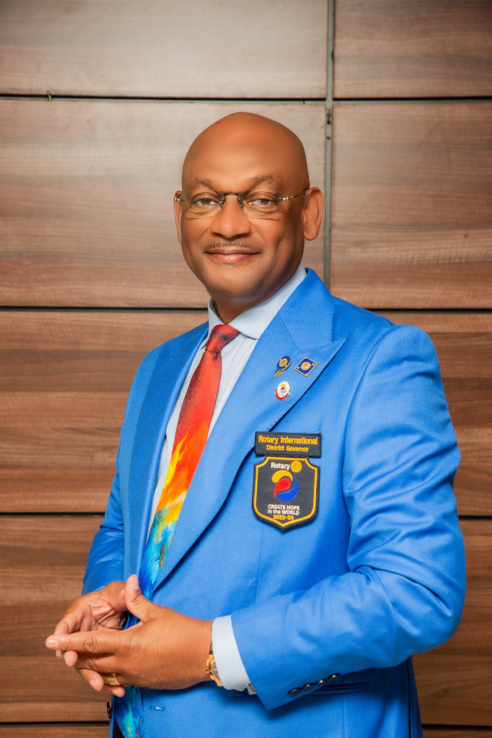
RI DISTRICT GOALS
District Goals and Plans for
Rotary D 9104
Year 2023 -2024
District Governor
David Osei Amankwah

Slide 9

“ENTER TO LEARN
GO FORTH TO SERVE”
RID. Patrick Chisanga

Slide 10
DISTRICT PLANNING GUIDE: SETTING DISTRICT GOALS
Club Administration
Membership
Training
Rotary Foundation
Public Image
Service Projects
New Generations/ Youth

Slide 11

CLUB ADMINISTRATION
Rotary Club Central: 100% Club Presence with updates Monthly
Presidential Citation: 80% Qualification

Slide 12

MEMBERSHIP
To help Clubs develop STRATEGIES to ATTRACT members
To help Clubs develop STRATEGIES to ENGAGE members.
To promote the idea of Clubs reflecting diversity in their communities.
To support innovation in Clubs and Membership
To promote growth through the creation and expansion of Clubs.

Slide 13
Membership: + 200
Membership Engagement: 100%
Membership Attraction: 5 per Club
Membership Retention: 95%
New Club Development: 5
Accra: 2
Kumasi: 2
Tamale: 1

Slide 14
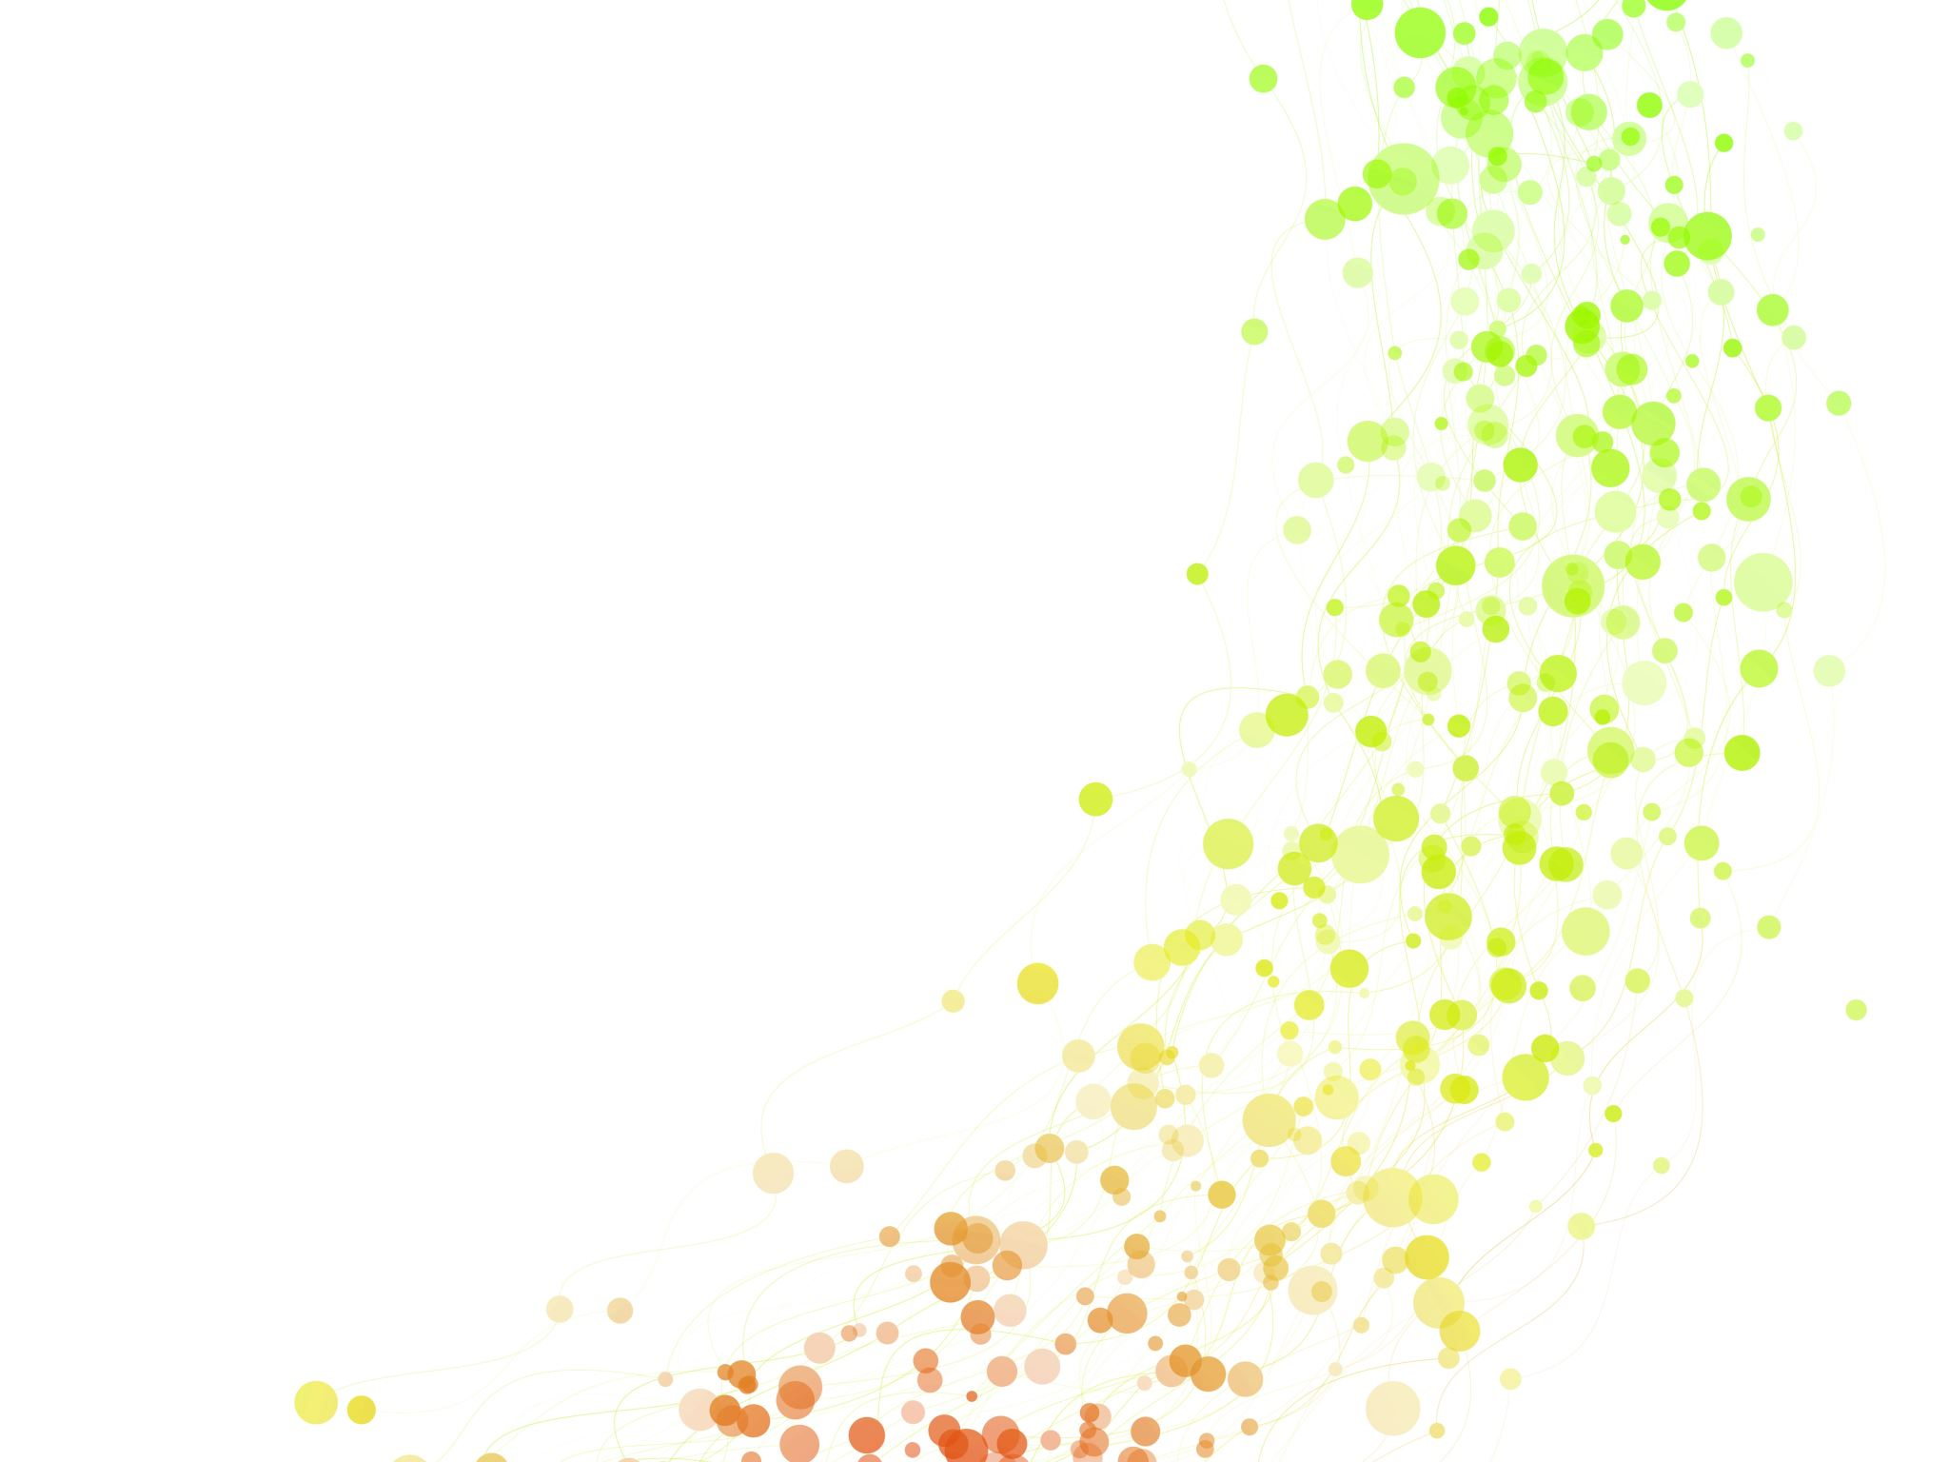
TRAINING
Club officers: President, PE, PN
  At least RLI Part 1 course
AGs and District Committee Chairs
  At least RLI Part II course
District Training
  80% Participation by Club/Board Rotarians
Club Training
  50% Participation STAR (Special Training for Action in Rotary)

Slide 15

Rotary Learning (RLC):
Every Rotarian must attempt a weekly visit to the RLC(To encourage its use at Club meetings) for 5 minutes on phones/tablets etc.
Enhance the District Leaderboard programme with Quarterly awards.
Notes:
Dcq d dd d d

Slide 16


ROTARY FOUNDATION
EREY: Every Rotarian Every Year
PHFs: 2 per Club = 120
Major Donors: Level 1: 10
  Level 2: 4
  Level 3: 2
Bequest Society: 2
Benefactors: 10
100% Club giving: 80%
District Goal: $200,000
Each Club must contribute a minimum of 1,500 USD to the Polio Plus Fund.

Slide 17

Opportunities to Give
Polio Plus Fund (supports a polio-free world)
A specific area of focus
An approved global grant
Annual Fund (Supports Rotary’s Current Work)
Endowment (Supports Rotary’s future)
World Fund Gifts (spent where need is greatest)
Disaster Response Funds
Rotary Peace Centers

Slide 18
Observe World Polio Day impactfully.
Consistently promote the PolioPlus Fund and fundraise for it.
Make our polio eradication efforts relevant and engaging for younger members and Rotaractors.
Know about the Bill and Melinda Gates Foundation 2-1 matching agreement.
Know that the Trustees of RF have asked Clubs to contribute at least $1500 to the PolioPlus Fund every year!
As a district we have allocated 20% of our District Designated Fund (CDDF) to PolioPlus.
Note that DDF allocation to PolioPlus are matched at 50% by World Fund!

Slide 19
PUBLIC IMAGE
Strategies:
Increasing the public’s understanding of our work helps us expand our reach.
To facilitate telling Stories of lives touched can help us promote our brand and the value of membership.
Must promote a culture of innovation
1
2
3

Slide 20
PUBLIC IMAGE
Strategies:
To ensure clear and consistent Branding and messaging.
To identify and leverage partnerships.
Club must provide resources to enhance public image.
4
5
6

Slide 21
PUBLIC IMAGE/PROMOTE ROTARY
Clubs to coordinate with Secretariat with provision of service projects images to place on District website and Mobile App.
Clubs must promote the display of service projects in the media via media encounters.
PI chairs must attend training to be offered by the District – particularly to appreciate the exposure of PI tools available to Clubs.
Continue, reinforce “People of Action” campaigns
1
2
3
4

Slide 22
PUBLIC IMAGE/PROMOTE ROTARY
Collection of Clubs must promote and complete (a) visible Rotary image(s) in each Regional Capital.
Promote the use of:
New District Mobile App
Enhanced District Website.
Promote the use of online branding tools
5
6
7

Slide 23
SERVICE PROJECTS
Service projects have the singular objective to be IMPACTFUL.
When we talk about Rotary’s impact, we refer to the positive, long-term change that results from our actions.
We want people in our communities and around the world to know about it.
The Building Blocks are:
Input | The resources invested in a project | Example: Time, Money, training and materials used for project/program
Output | Immediate results of a project | People trained Materials delivered People and institutions engaged
Outcome | The short term or intermediate results of a project | Adoption of systems and/or practices encouraged by the project.
Impact | The positive long-term changes resulting from our actions | Example: Measurable improvement that otherwise would not have happened

Slide 24
DISTRICT PROJECTS
To have sustainable projects that have measurable goals and outcomes.
Projects must support objects of RI and TRF.
To encourage clubs to support and participate in District Projects.
Joint projects: Interact + Rotaract.
Joint projects/ Collaboration with non-Rotary organization.

Slide 25

Targeted District Projects
Documentary on History of Rotary in the District and Ghana (1958 to present) –
  “Charting a new course: Rotary Ghana”
Mobile App (D 9104).
New D9104 Website.
A major health initiative.

Slide 26
D 9104: SOLAR VACCINE SHELTER PROJECT
Does the project have a clear goal and measurable outcomes?
Why does, the project or programme work?
Is the project relevant to many communities? Is it adaptable to different settings?
What elements are essential, and What is optional but useful?
Are different partners, organizations needed to expand the project?
What is Rotary’s role in making this project a success? Will that change it scaled? How can Clubs and the District work together to engage members in this project?

Slide 27

NEW GENERATION/YOUTH
The goals are:
To publicize and support vibrant youth and young adult programmes.
To adhere to Youth protection standards.
Promote a service project(s) to help empower young girls.
Club Formations + Events
Interact: 10 New Clubs.
Rotaract: Nett of 3 Clubs.

Slide 28
NEW GENERATION/YOUTH
Youth Exchange: To promote the use of Virtual Exchange Programmes
>2 youth Exchange programmes.
RYLA: To hold a District RYLA event.
District Committees/Activities - must include Rotaractors.
District Public Image project – Rotaractors must be prominent in the implementation.

Slide 29

ENVIRONMENT:
To embark on nationwide District Environmental Service Project – “Planting 1,000 trees in 100 Schools”
Have 2 major symposia on the environment one of them in conjunction with World Environment Day.
Appoint a “Green Ambassador” to effect/coordinate/execute the Environment Project!

Slide 30
OTHERS
Registration of 800 Rotarians for DAC 2024.
Registration to RI Convention Singapore of 100 Rotarians.
Achieve Zero non-giving Clubs to TRF.
Subscription of 80% to Rotary D9104 Mobile App
Promote a Mental Health Awareness campaign that promotes and maintains well being in Rotarians, in the community and any focus groups. We will set up an SMS helpline, available on the District App to support Rotarians needing help

Slide 31
Imagine Positively,
Imagine beyond Words,
Imagine beyond Dreams,
Imagine going beyond Ourselves,
Let’s look back on this year and say that,
We have imagined fearlessly,
Now let’s take a step into our new District,
Let’s be BOLD, let’s be PHENOMENAL!
“You are the leaders who will create hope.
CREATE HOPE in the WORLD as you exit these doors and ignite the world”

Slide 32
“Action without vision is wasted, and vision without action is just a dream.
Action with vision brings hope to the world.”
1996-97 RI Pres. Luis Vicente Giay
- Address to 1996 Rotary Covention,
Calgary, Alberta, Canada

Slide 33
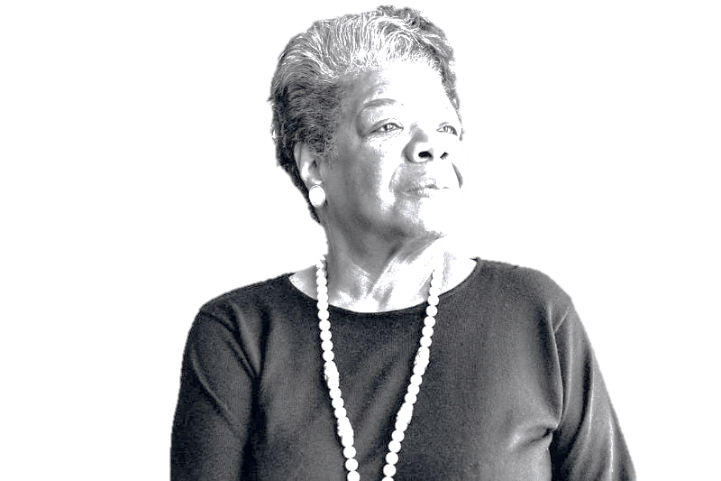
“PEOPLE WILL FORGET WHAT YOU SAID,
PEOPLE WILL FORGET WHAT YOU DID,
BUT
PEOPLE WILL NEVER FORGET HOW YOU MADE THEM FEEL”
Maya Angelou-

Slide 34

Gramps Morgan- “People Like You”

Slide 35
THANK YOU

Slide 36
District Leadership Team & Communication Structure
David Osei Amankwah
District Governor 2023-24

Slide 38
District Structure
District Governor
District Committee Chairs
Assistant Governors
Rotary Clubs
District Secretariat

Slide 39
District Leadership
District Governor
DG David Amankwah
District Secretary
PE Alice Otoo-Ocran
District Treasurer
PP Frank Offei-Ansah
District Vice Governor
PDG Victor Yaw Asante
District Governor Elect
DGE Florence Maame Hagan
District Governor Nominee
DGN Nana Yaa Siriboe

Slide 40
District Governor’s Advisors
PDG Sam Worentetu
PDG Jeffery Afful

Slide 41
District Committee Chairs
District Membership Chair
PDG Yvonne Kumoji -Darko
District Finance Chair
PAG Emmanuel Quarshie
District Rotary Foundation Chair
PDG Winfred A.Mensah
District Public Relations/Image Chair
PAG William Ofori
District Training Chair
PDG Yvonne Kumoji - Darko
District International Service Chair
PAG Jack Dotsey

Slide 42
District Committee Chairs
District Rotaract Representative
DRR Dennis Amakye
District Foundation Fundraising Chair
AG Sam Asare - Konadu
District Community Service Chair
PAG David Tettey
District Alumni Chair
PP Andrews Ofosuhene
District Endowment & Major Gifts Chair
PDG Yvonne Kumoji Darko
District Annual Fund Chair
AG Sam Asare - Konadu

Slide 43
District Committee Chairs
District Fundraising Subcommittee Chair
PP Santosh Nair
District Membership Development Chair
PDG Yvonne Kumoji Darko
District Membership Attraction Chair
PAG Shika Acolatse
District Grants Subcommittee Chair
PAG Frank Debrah
District New Club Development Chair
PDG Sam Worentetu
District Membership Engagement Chair
PAG Shika Acolatse

Slide 44
District Committee Chairs
District New Generation Service Exchange Chair
PP Eric Botey
District Paul Harris Society Coordinator
AG Samuel Asare Konadu
District Polio Plus Subcommittee Chair
DGN Nana Yaa Siriboe
District RI Convention Chair
DGE Maame Hagan
District DTAC Promotion Chair
PP Henry Atiase

Slide 45
District Committee Chairs
District Interact Chair
Rtn Linda Maku
District Rotary Friendship Exchange Chair PAG Awal Babah - Alargi
District RYLA Chair
PP Christine Adams
District Rotaract Chair
PP Kwame Baah - Acheamfuor
District Rotary Scholarships Chair
Rtn Hilda Ampadu
District Rotary Peace Fellowship Chair
Rtn Juliet Amoah

Slide 46
District Committee Chairs
District Stewardship Subcommitttee Chair
PAG Emmanuel Quarshie
District Vocational Training Team Subcommittee Chair
Rtn Baptista Gebu
District Youth Exhange Officer
PP Neyeram Kukula
District Youth Protection Officer
PP Patricia K. Effah
District Diversity,Equity and inclusion Officer
PAG Theresa Osei - Tutu+
HOC Vice Chair
AG Afua Ababio
HOC Chair
PAG Russel Banful

Slide 47
District Secretariat
Assistant Secretary
PP Roma Puni
Assistant Treasurer
PAG Galina Okartei-Akko
District Editor – in - Chief
Rtn Baisiwa Duwuona
District Website Chair/Social Media
Yet to be confirmed
District Media
Yet to be confirmed

Slide 48
Assistant Governors
AG Festus Amoyaw (RC Accra Ridge) | Accra – Osu RE
 | Accra – Achimota
 | Accra – Tesano
 | Tema – Sakumono
 | Accra
AG Anita Griffiths (RC Sekondi-Takoradi) | Cape Coast – Central
 | Winneba
 | Accra - McCarthy Hill
 | Weija - West
AG John Totoe (RC Accra-Airport) | Accra - Cantonments East
 | Accra – North
 | Tema
 | Accra – Kanda
AG Mumuni Haruna (RC Accra-East) | Accra - Ring Road Central
 | Accra – South
 | Accra - Dansoman
 | Accra - La East
 | Tarkwa
AG Naana Agyeman Mensah (RC Accra-Airport) | Accra – Dzorwulu
 | Accra - Roman Ridge
 | Accra – East
 | Accra - Spintex

Slide 49
Assistant Governors
AG Violet Anna Osei (RC Accra- West) | Accra - Airport
 | Akuapem – Ridge
 | Accra – Trinity
 | Accra – Speakmasters
AG Samuel Asare-Konadu (RC Accra – Legon East) | Akosombo - Dam City
 | Accra - West
 | Ho
 | Accra - Westlands
 | Accra - Adenta
AG Rudolph Kantum Adageba (RC Kumasi-East) | Bolgatanga
 | Tamale
 | Kumasi
 | Wa
 | E-Club Ghana
AG Michael Frimpong (RC Accra) | Accra - Industrial
 | Sekondi - Takoradi
 | Takoradi - Anaji
 | Accra Labone

Slide 50
Assistant Governors
AG Afua Ababio (RC Accra-Airport) | Accra - Sunrise
 | Accra -Premier International
 | Accra - Airport City
 | Accra - Ridge
AG Nana Esi Adade Amankwah (RC Kumasi) | Accra - Teshie Nungua
 | Accra - Airport East
 | Obuasi
 | Kumasi - East
AG Tony Asare (RC Ring Road Central) | Accra – Cantonments
 | Accra – Osu Oxford street
 | Techiman
 | Adjiriganor
AG Jerry S. K. Otchi (RC Accra-Labone) | Kumasi - Nyieaso
 | Sunyani - Central
 | Sunyani – East
 | Accra - Legon
AG Joseph Dzamesi (RC Ho) | Koforidua
 | Hohoe
 | Tema - Community 25
 | Tema Meridian
AG Nathaniel AMEDZRO (RC Accra-Tesano) | Accra – North Kaneshie
 | Accra – Legon East
 | Accra – Morning Tide
 | Kumasi

Slide 51
DISTRICT GOVERNOR
DISTRICT
SECRETARIAT
PAST + INCOMING GOVERNORS
COMMITTEE CHAIRS
ASSISTANT GOVERNORS
ROTARY CLUBS
Primary communication structure

Slide 52
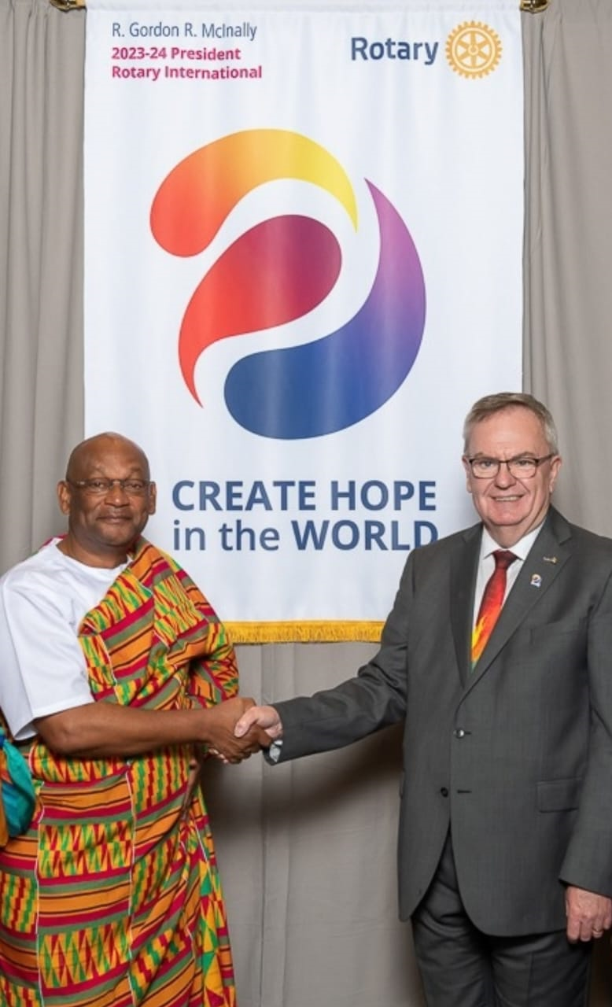



DGE’S Social Media HANDLES
dg23@rotarydist9104.org
info@rotarydist9104.org
@dg23dave9104
@dg23dave9104

Slide 53


Slide 54

DISTRICT EVENT CALENDAR
2023-2024

Slide 55
Quarter 1
Event | Date
Investiture / District Handover of DG Dave Amankwah | July 08, 2023
District Rotaract/National & Club Handover Dinner | July 22, 2023
Complete Club Board and Committee Chair Orientation and Submit report sheet | July 01 – 22, 2023
International Youth Day | August 12, 2023
District Membership Seminar | August 26, 2023
4th All Africa Zone Institute, Lusaka Zambia | September 4 –10, 2023

Slide 56
Quarter 2
Event | Date
District Interact Week | October 29 – November 1, 2023
Rotaract Africa Summit Ghana | 23rd – 26th November 2023
West Africa Project Fair | November 1-8, 2023
Rotary Foundation Concert | November 30, 2023
District Foundation Seminar | November 18, 2023
Council of Governors meeting | December 2, 2023
District Finance Committee | December 2, 2023
District Nominating Committee Meeting | December 2, 2023

Slide 57
Quarter 3
Event | Date
District Public Image Seminar | January 27, 2024
Rotary Family Health Days | February, 2024
Rotary Day - Intercity Meeting | February 23, 2024
Walk for Rotary | February 24, 2024
Rotaract Week | 1st March 2024
District Team Training Seminar (CLTS)/Club Leadership Training Seminar (DTTS) | 16th March, 2024

Slide 58
Quarter 4
Event | Date
Rotaract DTAC | April 5 - 6, 2024
DTAC | April 12 – 13, 2024
RYLA | April 2 - 4, 2024
Rotary International Convention, Singapore 2024 | May 25 – 29, 2024
World Environment Day | June 5, 2024

Slide 59
OTHERS
Event | Date
RI Presidential Conference | TBC
Charter Presentation | TBC
Special Events | TBC
Anniversary Celebrations | TBC

